Slide 1
Incremental sales growth
eBusiness Customers

Slide 2
Overall findings
FEI customer increase their sales by ~21.51% after becoming an eBusiness customer
Since average historical sales per month of this group is roughly $18,059, we realize incremental sales of $3,884 per customer per month ($46,614 annual)
See methodology to get details on matching & regression details
Notes:
“Ive researched the effect of becoming an ebusiness customer on total sales. It seems there is a statistically and economically significant increase occurring. After holding constant many differences between customers and across time, using a couple different econometric methodologies, ive arrived at the following conclusions” Chris Brossman – eBusiness Analytics

Slide 3
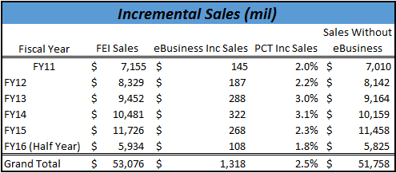
overall
eBusiness added $268 million in Incremental Sales in FY15
FEI FY15 Sales ~ $11.72B
Without eBusiness FY15 Sales = $11.45B or 2.3% decline

Slide 4
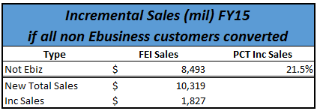
What if…
What if all customers were eBusiness customers?
Ferguson FY15 Sales = $11.72B
Faster growth towards a $25B Company
Enhance ability to become #1 in every KOB in every market we serve
$1.8B in sales were left on the table in FY15 (21.5%)

Slide 5
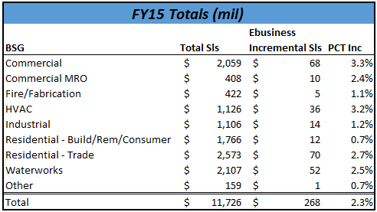
Business group

Slide 6
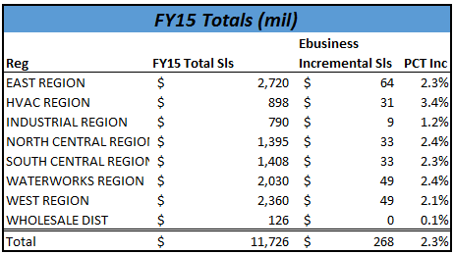
Region breakout

Slide 7
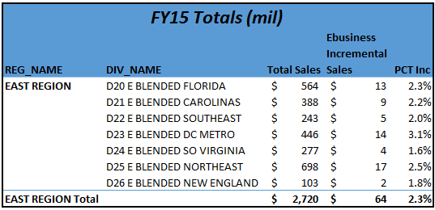
District - east

Slide 8
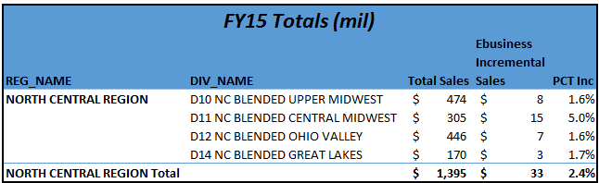
District - nc

Slide 9
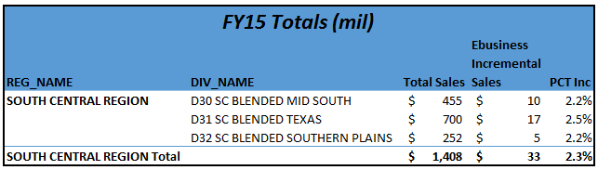
District - sc

Slide 10
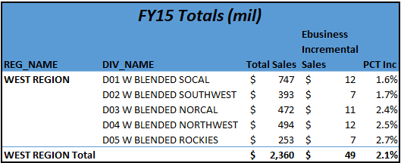
District - west

Slide 11
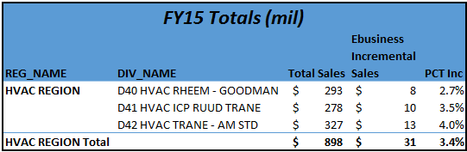
District - hvac

Slide 12
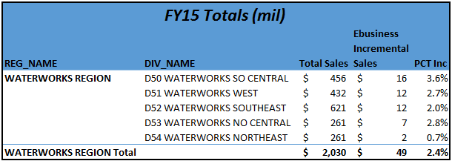
District - waterworks

Slide 13
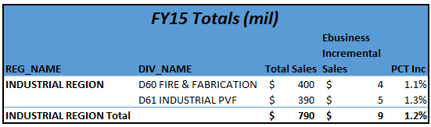
District - indust

Slide 14
Conclusion
How we got here:
eBusiness BDMs & Specialists in the Field
Sales Calls with OS Reps Leveraging Relationships
Adoption Rate Increase
Drive Change
eBusiness HQ
System to System implementing faster system integrations
Merchandising specific to Business Group product strategy
Email marketing aligned with Business Group message
User Experience deliver on customer functionality expectations
Analytics team delivering actionable insight for sales focus
How we grow faster:
Phase 2 Platform successfully implemented
Mobile App lineup increased, enhanced
Continued resource support
Ferguson’s ability to enhance our customer’s business process has grown wallet share

Slide 15
Appendix Methodology Matching & D.I.D. Fixed effects for non technical audience --------------------------------------------- See detailed explanation if desired ---------------------------------------------

Slide 16




The need for matching
FEI Customer Population
FOL Customer Population
Not Comparable
Samples are not consistent because treatment is non random – eBusiness sought after most desirable FEI customers for FOL

Slide 17
The need for matching
FEI Customer Population after matching
FOL Customer Population
Comparable
Matched samples will greatly reduce bias. We still need to control for differences within each population. Regression will help.

Slide 18
Still need to hold control for other “stuff” that explains differences
Anything else that can explain sales changes will contaminate the “eBusiness” effect
We need to control for this to isolate “eBusiness” effect
Things held constant in analysis using Fixed Effects Regression
Fixed Effects (things that don’t change over time)
Such as type of customer
Macro Economic Effects
(economic changes in US)
Micro Economic Effects at Branch level
(economic changes in MSA)
Tenure
Individual time – loosens assumption of design

Slide 19
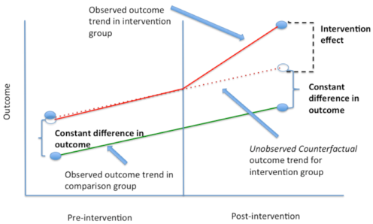
difference in difference: after isolation of ebus effect

Slide 20
Appendix Methodology Matching & D.I.D. Fixed effects --------------------------------------------- more detailed explanation ---------------------------------------------

Slide 21
Matching
What is matching?
Matching is a technique to match the treated group with those not treated in the population but who are similar to emulate a suitable control
Why is it important?
Matching reduces bias, when the treated group differs greatly from the overall population, or if the treatment is non-random.
FOL or S2S customers are much larger than the average FEI customer for example. Treatment is non-random
See here for more details:
https://en.wikipedia.org/wiki/Matching_(statistics)

Slide 22
Matching
Who was included prior to matching?
Customers with 6 months or more of FEI data
Customers with greater than 10,000 in total lifetime spend
Customers with greater than 10 lifetime orders
Customers with greater than 50 lifetime lines items.
What type of Matching was used?
Distance = Logit, method =Nearest Neighbor, 1-1 matching, with replacement
Example Logit Formula:
EVER_EBIZ_CUST ~ DOM_TYPE_II + OS_HA + CREDIT_BIN + CNT_YM + I(log(SLS_PER_MONTH)) + I(log(SLS_PER_ORDER)) + I(log(SLS_PER_MONTH*SLS_PER_ORDER)) + PCT_JOB_SLS

Slide 23
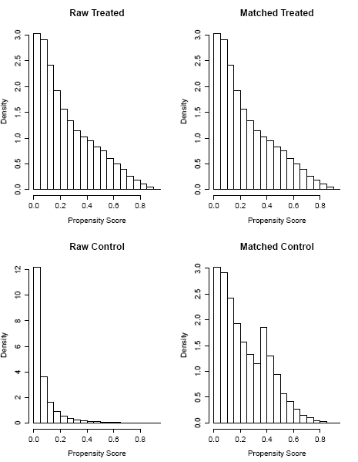
Matching – ebusiness
Treatment and control groups are not similar prior to matching
Treatment and control groups are much more similar after matching

Slide 24
data
Data used came from data warehouse/Appex tables:
Branch customer history
Ferguson customers
Matched Customers described earlier
Data was setup as panel
Each row represents a customer at a particular month
Each column represents variable of interest
Since this resulted in millions of rows, which became computationally difficult, roughly 25% of the customers were sampled
Robustness checks ensured a robust estimator.

Slide 25
Identification strategy
Difference in Difference Fixed Effects model
This model holds constant time invariant effects and uses the variation over time.
Example: being a plumber doesn’t change over time. All variables which don’t change over time were held constant
For more information go here
https://web.stanford.edu/~mbest/8_-_Panel_Data-Fixed_Effects_and_Differences_in_Differences.pdf

Slide 26
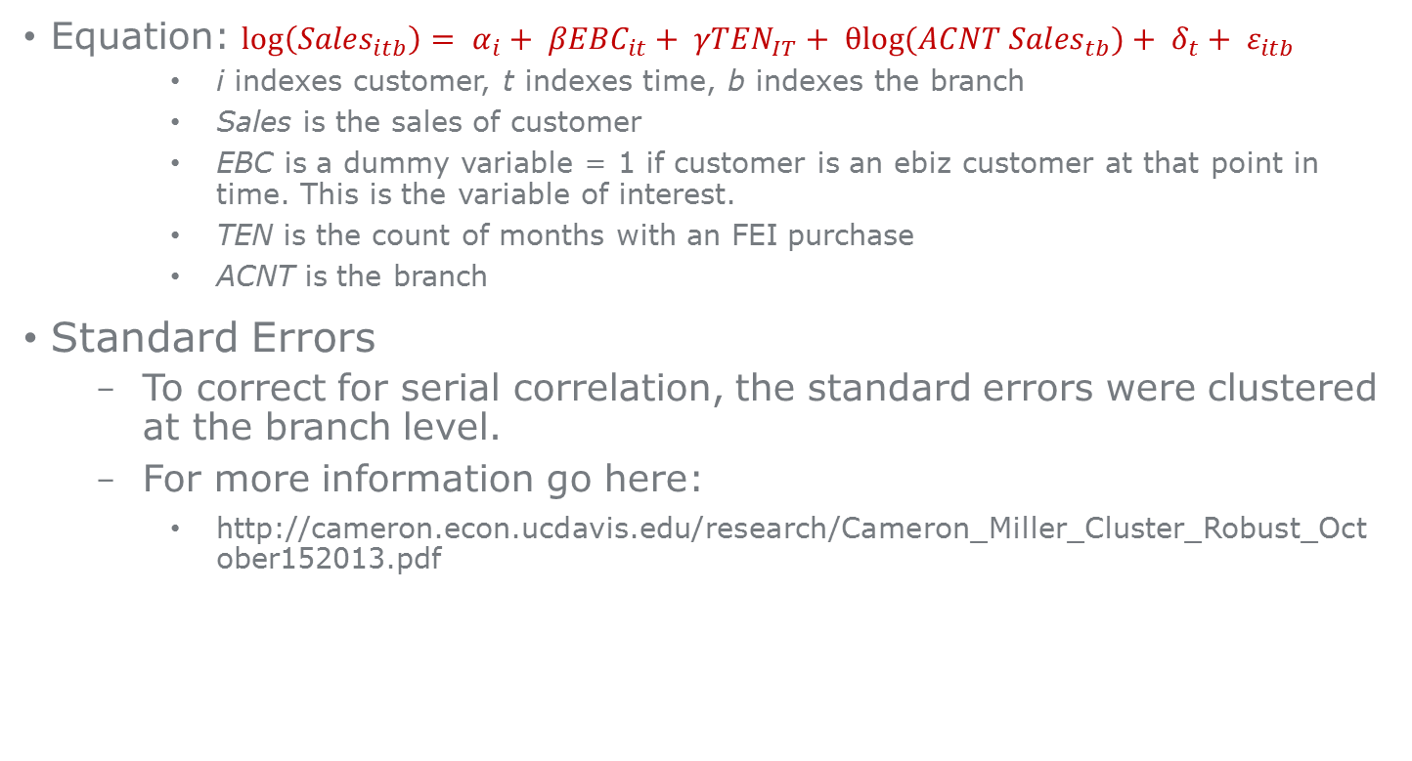
Identification strategy
Equation: $\log\left({Sales}_{itb}\right)= α_{i}+ {βEBC}_{it}+ {γTEN}_{IT}+ {θlog⁡(ACNT Sales}_{tb})+ δ_{t}+ ε_{itb}$
i indexes customer, t indexes time, b indexes the branch
Sales is the sales of customer
EBC is a dummy variable = 1 if customer is an ebiz customer at that point in time. This is the variable of interest.
TEN is the count of months with an FEI purchase
ACNT is the branch
Standard Errors
To correct for serial correlation, the standard errors were clustered at the branch level.
For more information go here:
http://cameron.econ.ucdavis.edu/research/Cameron_Miller_Cluster_Robust_October152013.pdf

Slide 27
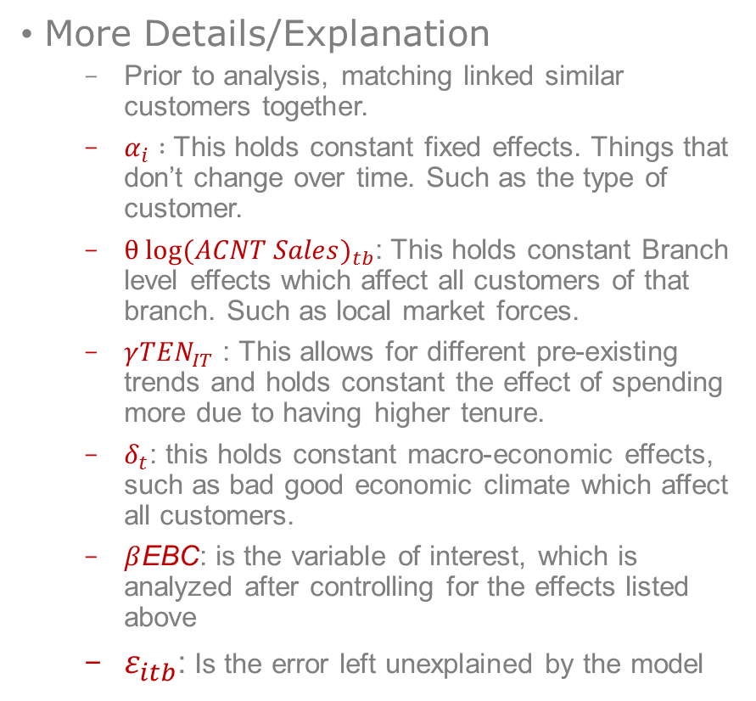
Identification strategy
More Details/Explanation
Prior to analysis, matching linked similar customers together.
$α_{i} :$This holds constant fixed effects. Things that don’t change over time. Such as the type of customer.
$θ {log⁡(ACNT Sales)}_{tb}$: This holds constant Branch level effects which affect all customers of that branch. Such as local market forces.
$γ{TEN}_{IT}$ : This allows for different pre-existing trends and holds constant the effect of spending more due to having higher tenure.
$δ_{t}$: this holds constant macro-economic effects, such as bad good economic climate which affect all customers.
$β$EBC: is the variable of interest, which is analyzed after controlling for the effects listed above
$ε_{itb}$: Is the error left unexplained by the model

Slide 28
All Data & analysis files
All data and analysis documents to recreate the analysis can be found here
S:\eCommerce\E-Commerce\Analysis & Reporting\Omni-Channel\eBiz effect on FEI sls
Programs used:
Oracle SQL
R

